Slide 1
Effects Of Spending On Health in Sub-Saharan Africa
Paul Suberu
5/10/2016
Introduction to Data Science

Slide 2
Background
Poverty
Health Crisis
Outbreaks of Infectious Diseases
International aid needed to solve these problems not internal solutions

Slide 3
Motivation
Increasing Human Capital
Leads to a Better economies and better general welfare
Policies that Work Best
Controlling the spread of Diseases.

Slide 4
Thesis
What has been the effect of increased or decreased expenditures on Health Sectors in Developing countries?
Has decreased Mortality rates
Increased Health Workers in the Area
Increased Immunization and Treatments of Diseases

Slide 5

Data

Slide 6
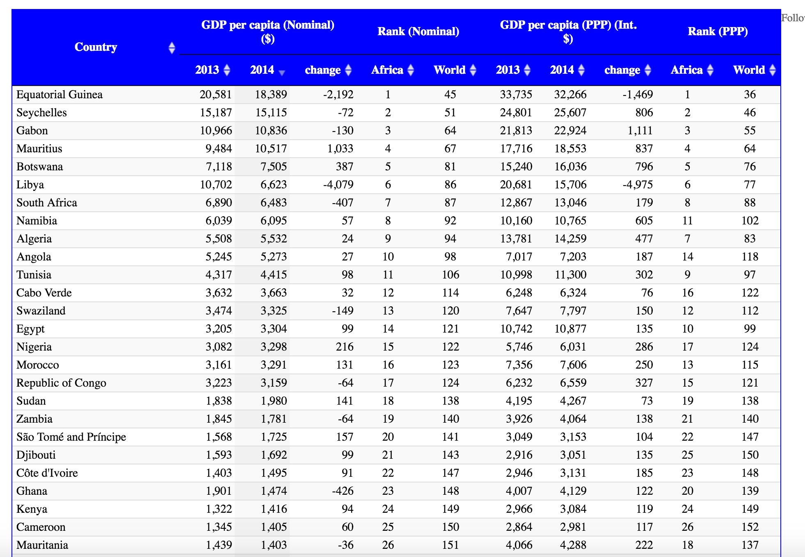
2002 2014

Slide 7
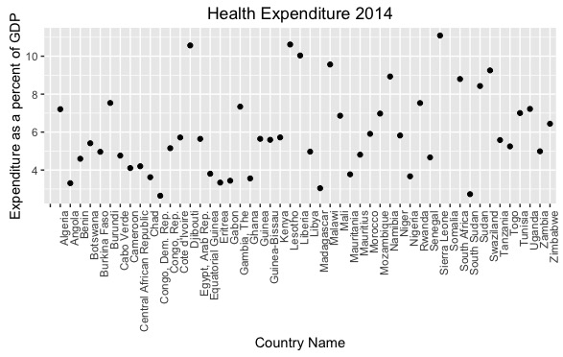

Slide 8
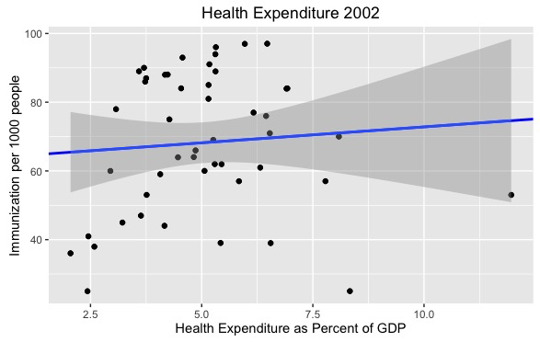
Graphs 2

Slide 9
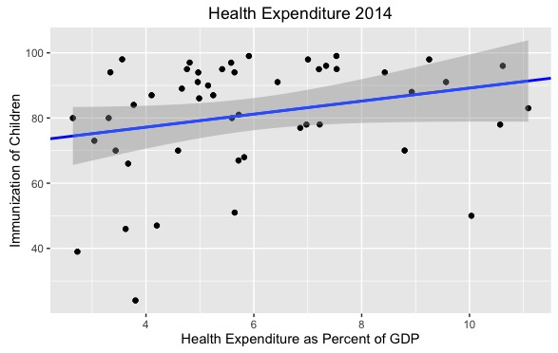

Slide 10
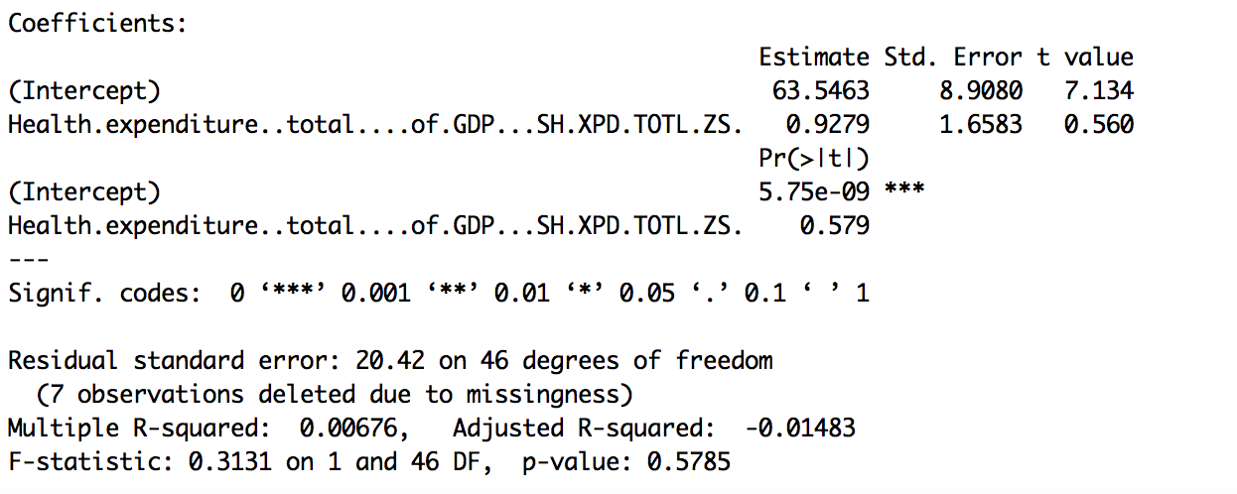
Regression Model 2002

Slide 11
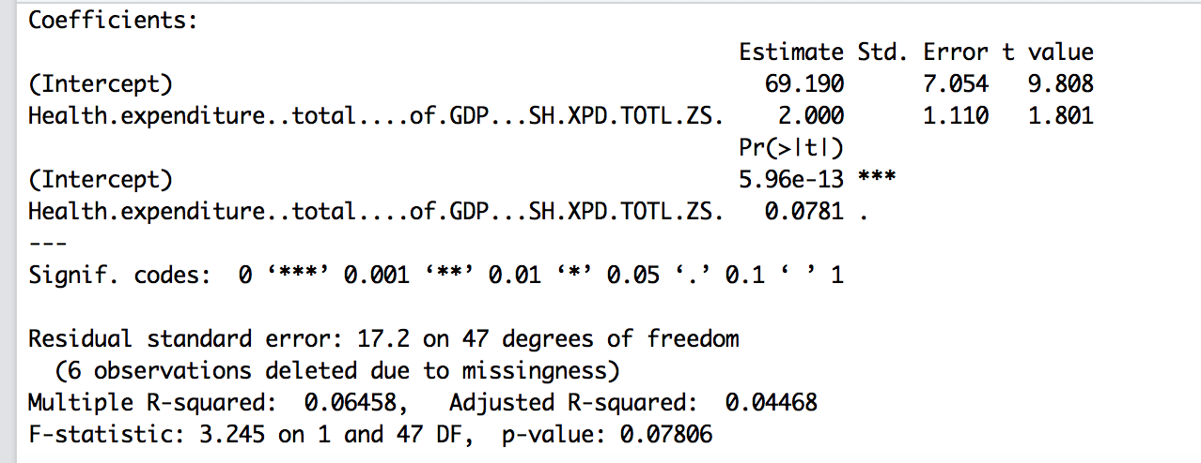
Regression Model 2014

Slide 12
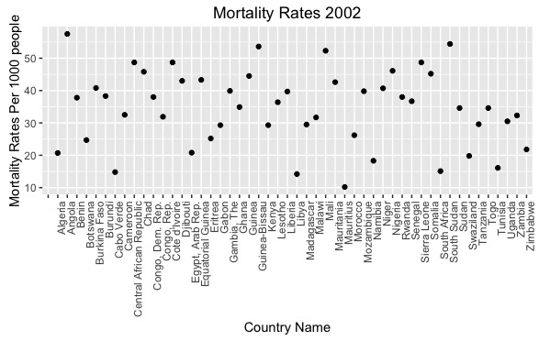
Mortality RATES 2002

Slide 13
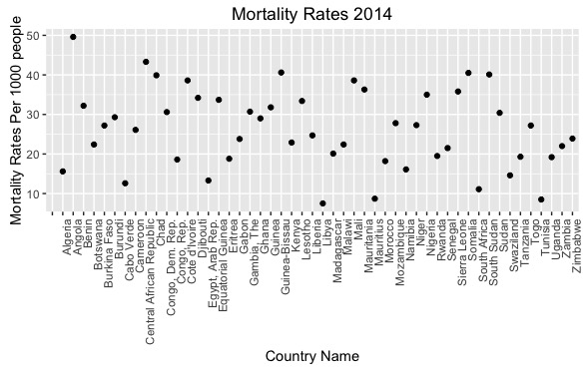
MORTALITY RATES 2014

Slide 14
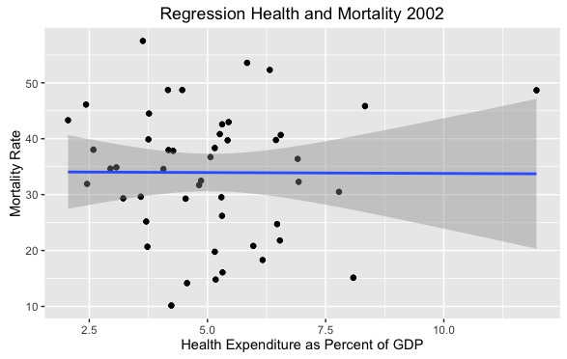

Slide 15


Slide 16
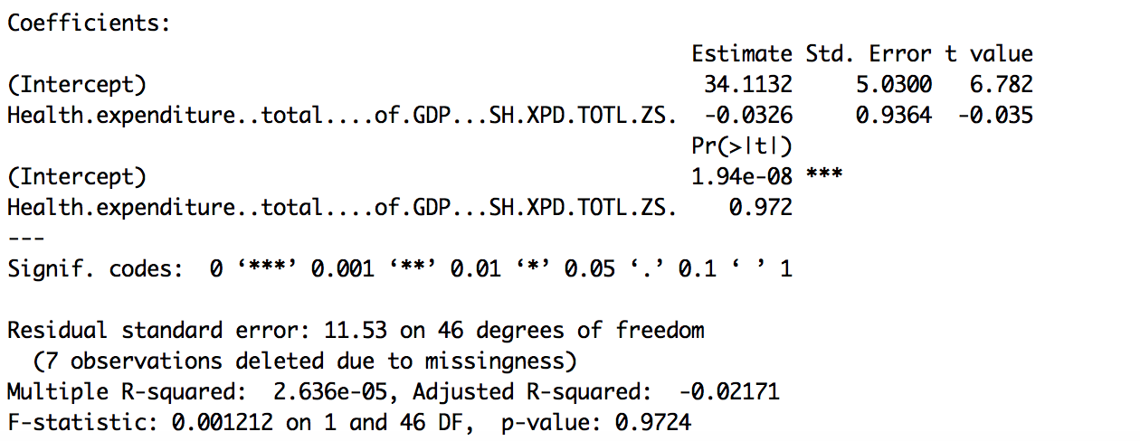
Regression Model 2002

Slide 17
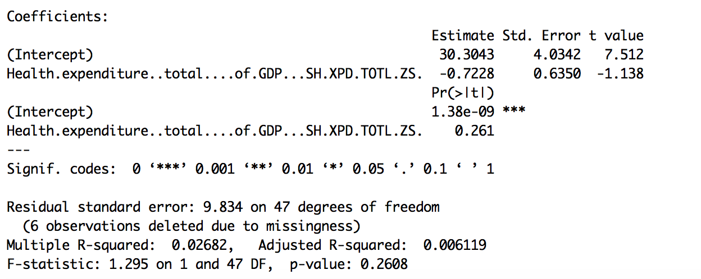
Regression Model 2014

Slide 18
Limitations
Countries don’t have the same Health systems. Doesn't’t take into account disparities between Health sectors
Looking at Countries Individually
Simple Linear regression

Slide 19
Conclusion
Some positive correlations between Expenditures and Decrease in Mortality rates
Some positive correlation between Increase in health expenditures and Immunization Rates
Create a Predictor Model

